Slide 1
Textile Spectroscopy
By Mitch Shiles

Slide 2


Slide 3
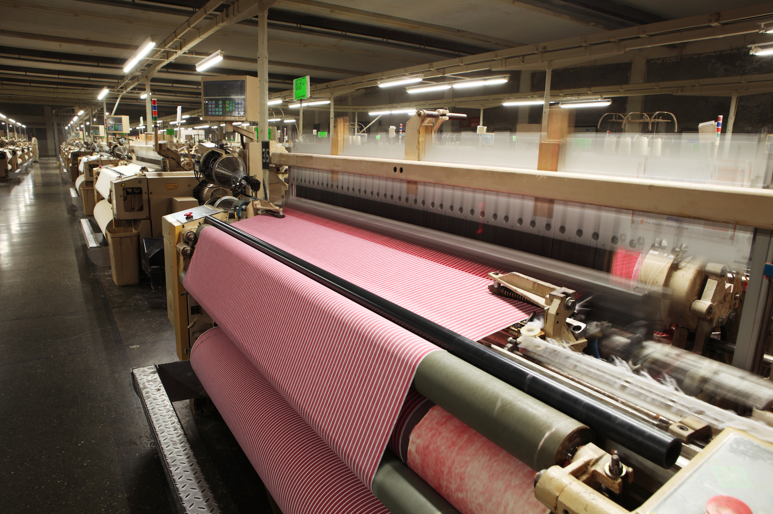
Textile production
https://fashion-history.lovetoknow.com/image/210907~Weaving-Fabric-on-Airjet-Looms.jpg

Slide 4
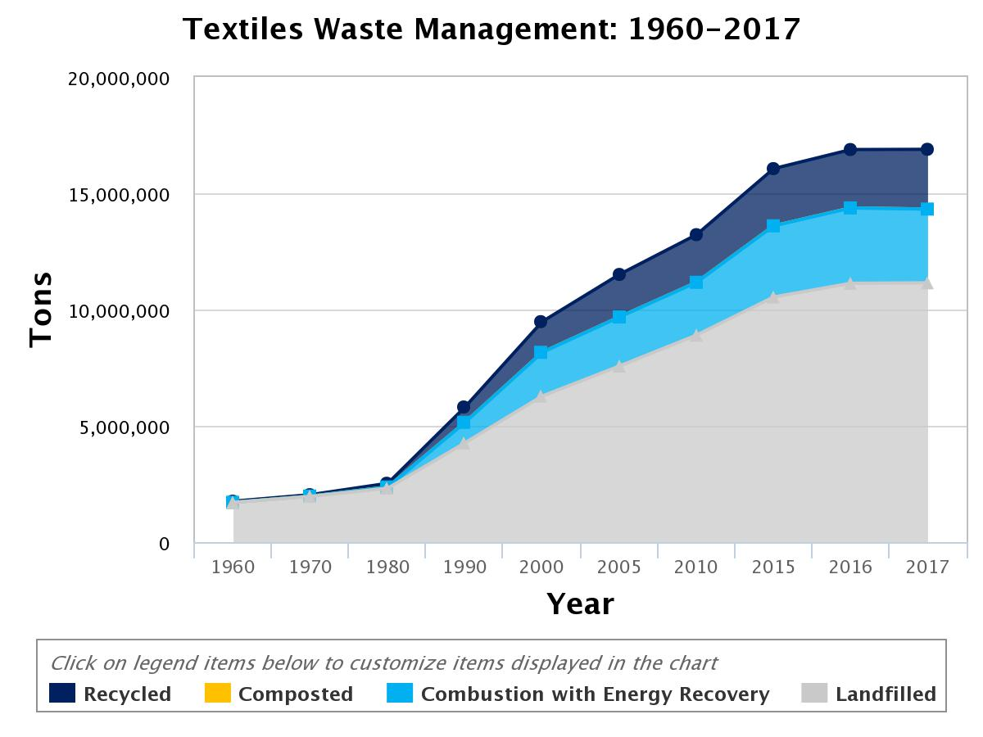
Textile Waste stream
https://www.epa.gov/facts-and-figures-about-materials-waste-and-recycling/textiles-material-specific-data

Slide 5
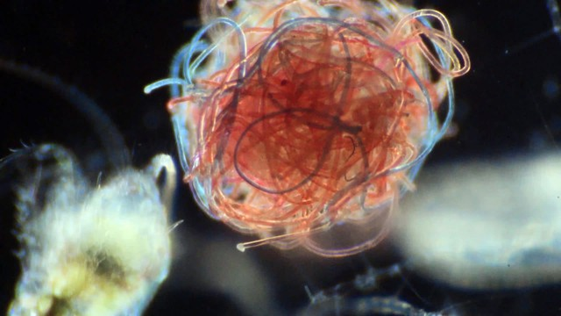
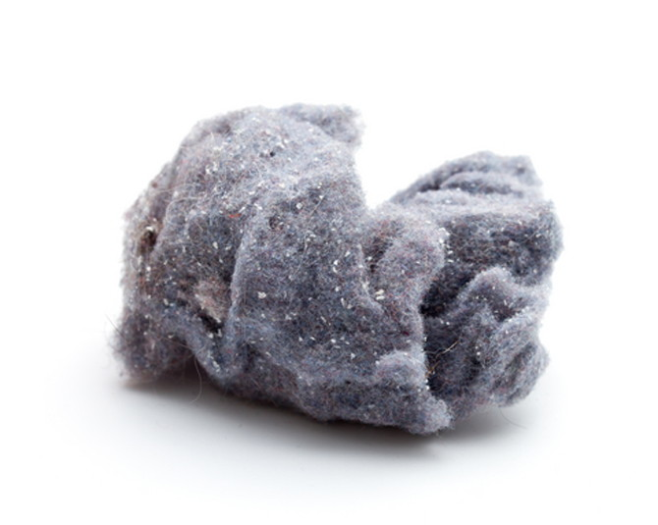
Lint and Ocean Microplastics
https://www.opb.org/news/article/oysters-with-a-side-of-microplastic/

Slide 6
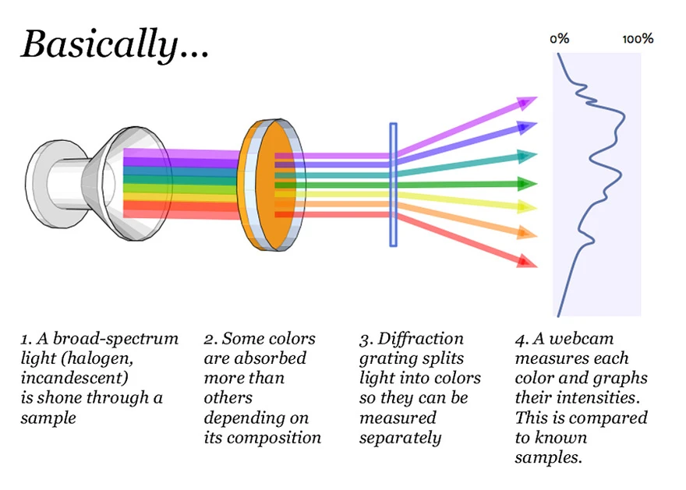
What is Spectroscopy ?
Spectroscopy is the investigation of interactions between matter and the electromagnetic spectrum
Often this involves measuring the emission, reflection, and absorption, of specific wavelengths by a material.
It can also be used measure things like magnetic resonance and atomic mass and gravtational waves
There are many different types of spectroscopy that can span the entire known electromagnetic spectrum
Spectroscopy can be used to identify materials

Slide 7
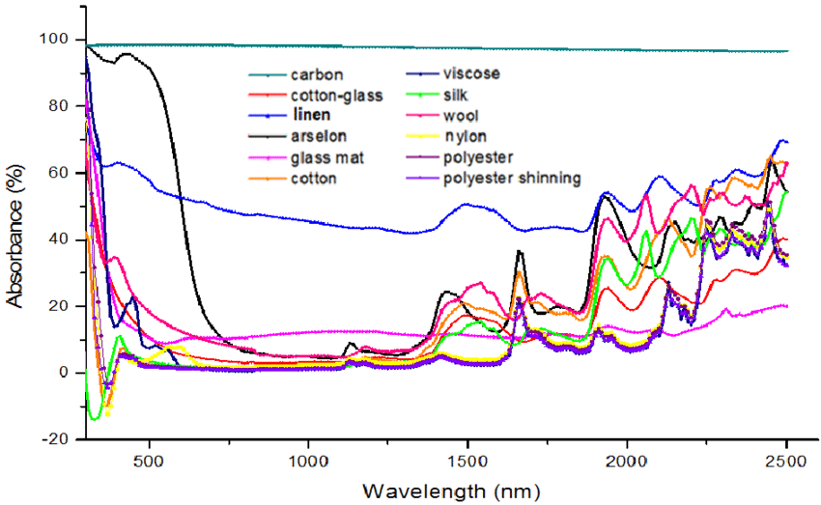
In this project Visible Light and Near Infrared spectroscopy is used.
Imagine a one pixel camera that instead of measuring red green and blue wavelengths it measured 18 different wavelengths from near ultraviolet to near Infrared

Slide 8
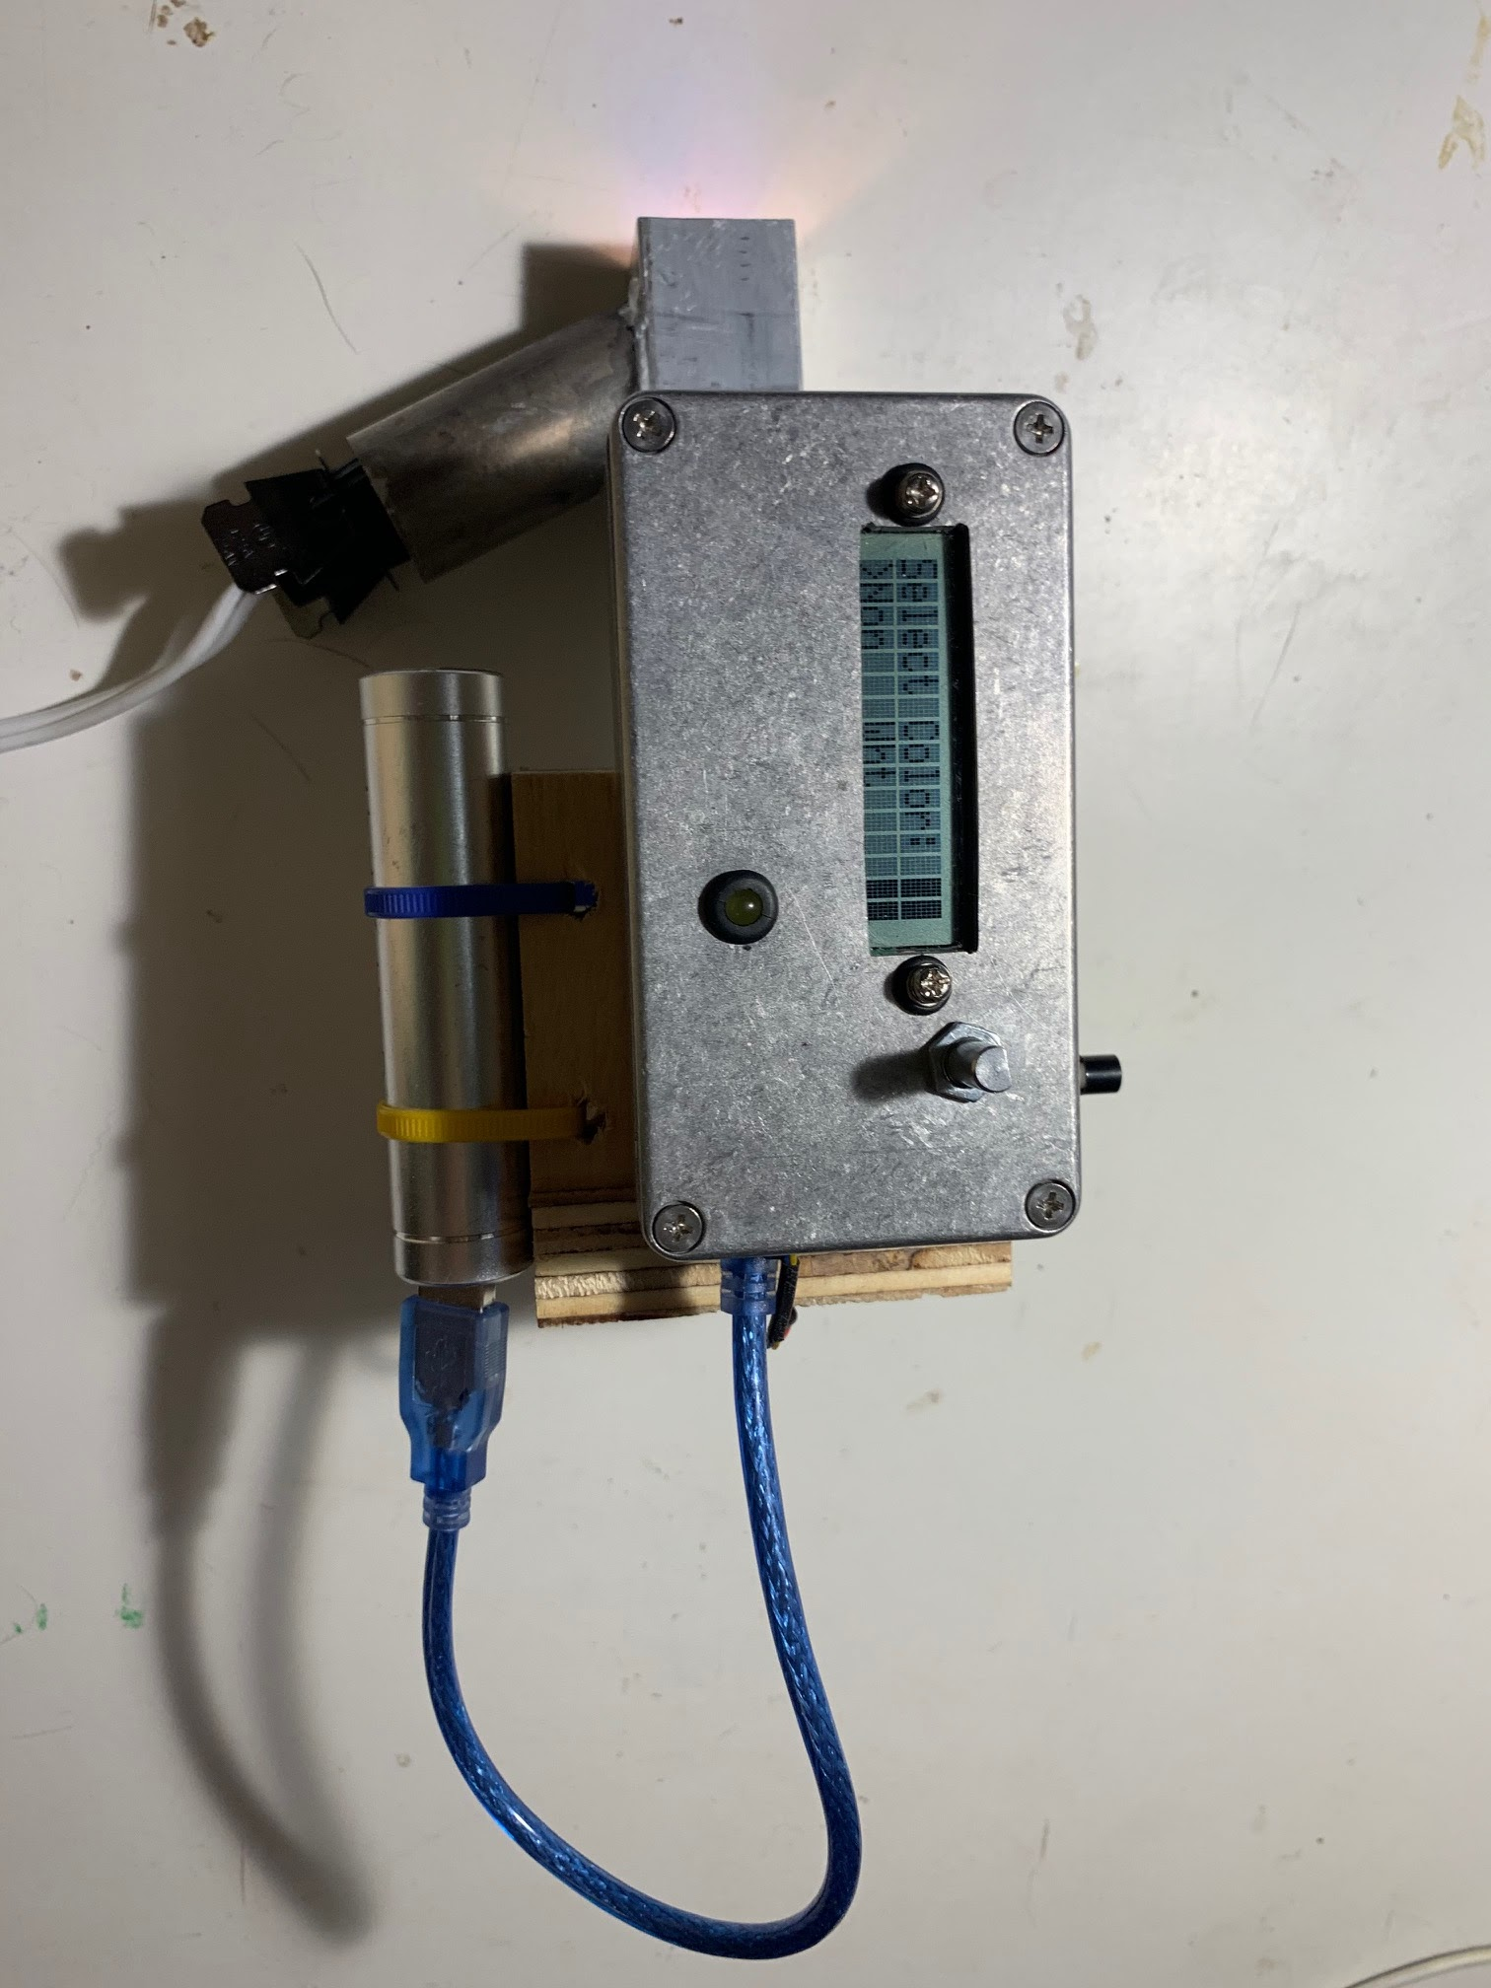
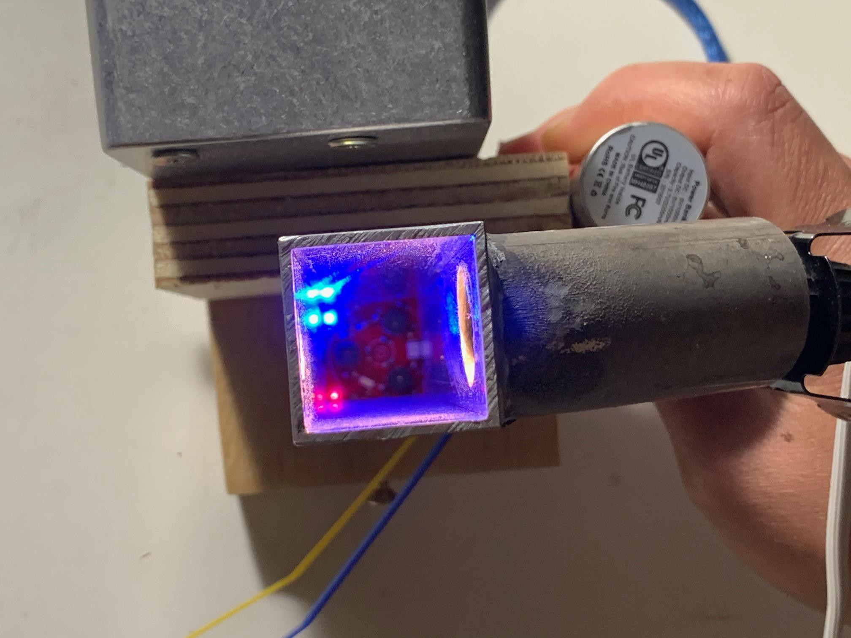
Data Collection Materials and methods
Imagine a one pixel camera that instead of measuring red green and blue wavelengths it measured 18 different wavelengths from near ultraviolet to near Infrared

Slide 9
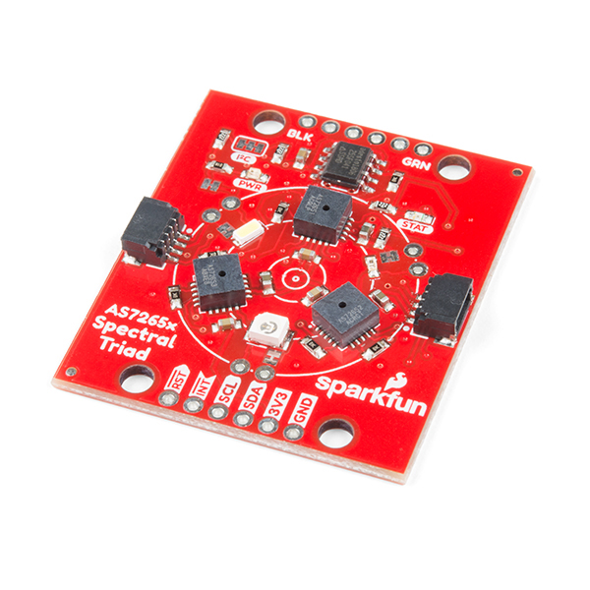
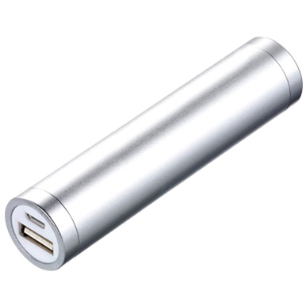
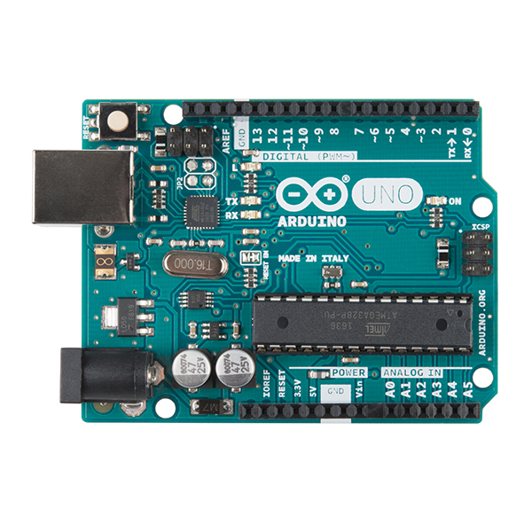
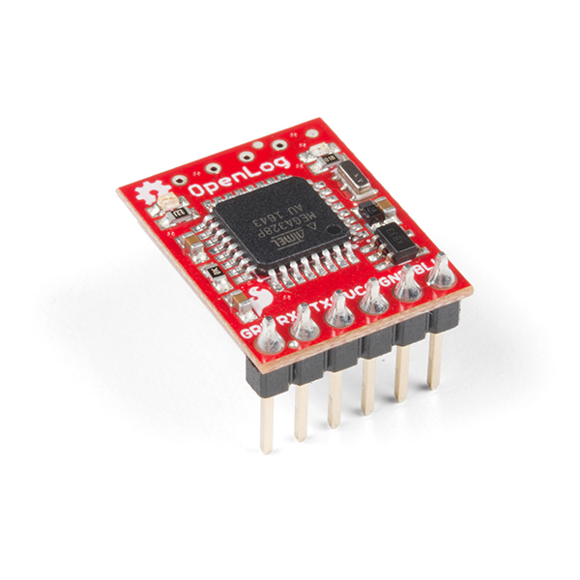
Data Collection: Materials and methods
Hardware
Sparkfun Triad Spectroscopy sensor
Arduino Uno R3
Open Log
16x2 LCD display
Rotary encoder
Momentary switch
T9 incandescent bulb
Portable phone charger
1” square aluminum tube
Various wires and cables
Small aluminum enclosure and some scrap wood

Slide 10
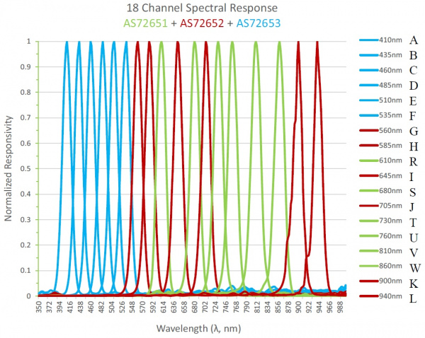

Slide 11
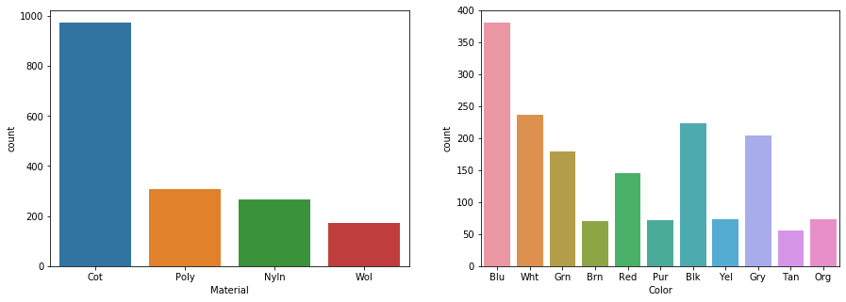
Class Imbalance

Slide 12
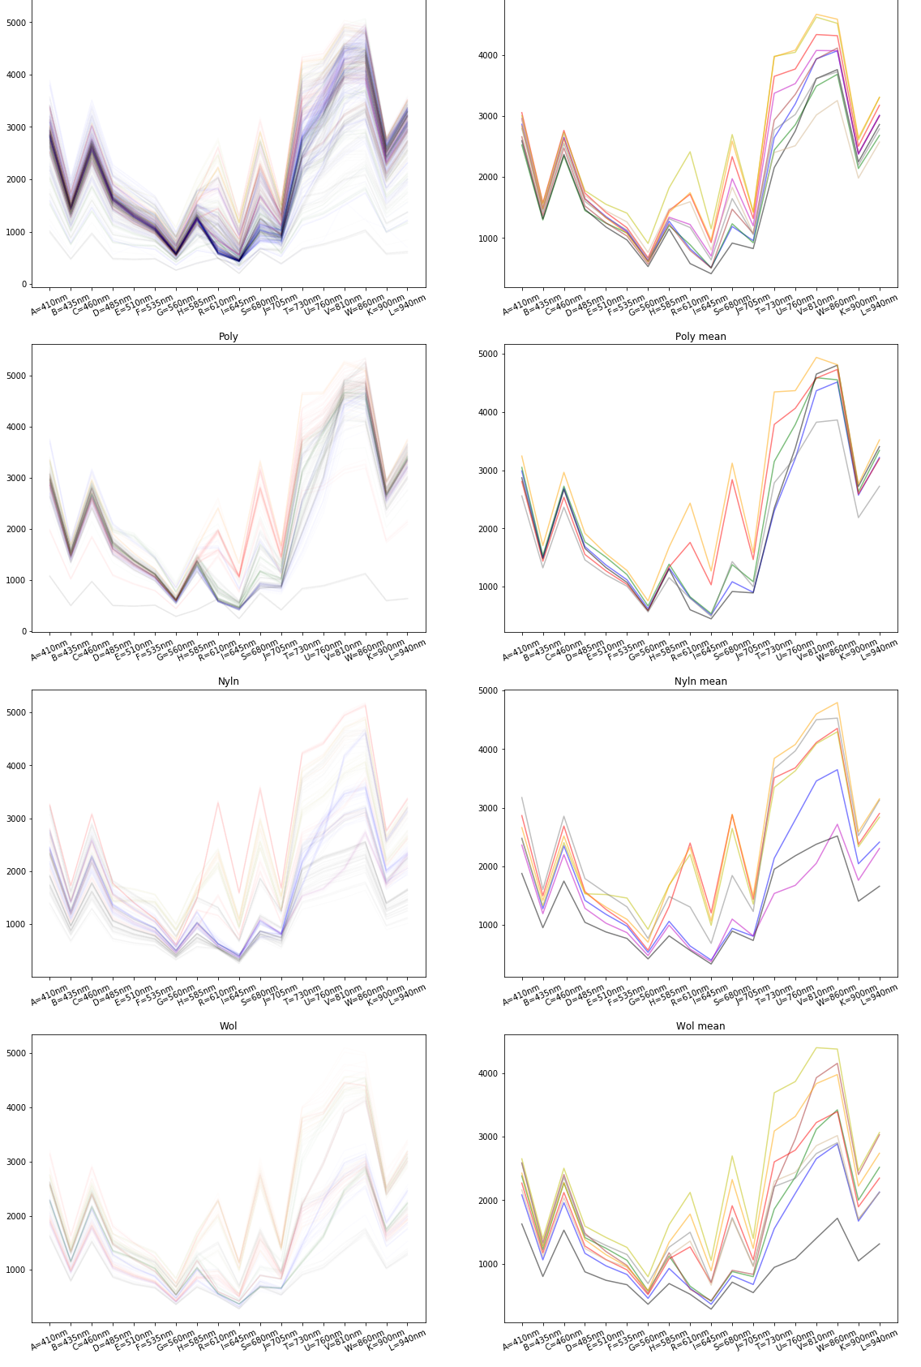
Data Exploration

Slide 13
Normalized Variables

Slide 14
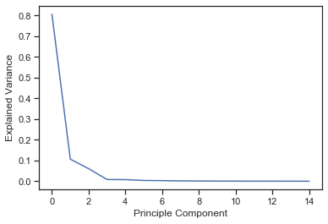
Principal Component Analysis
to retain 80.65% of total variance 1 components required
to retain 91.3% of total variance 2 components required
to retain 97.35% of total variance 3 components required
to retain 98.17% of total variance 4 components required
0.9999173569259071

Slide 15
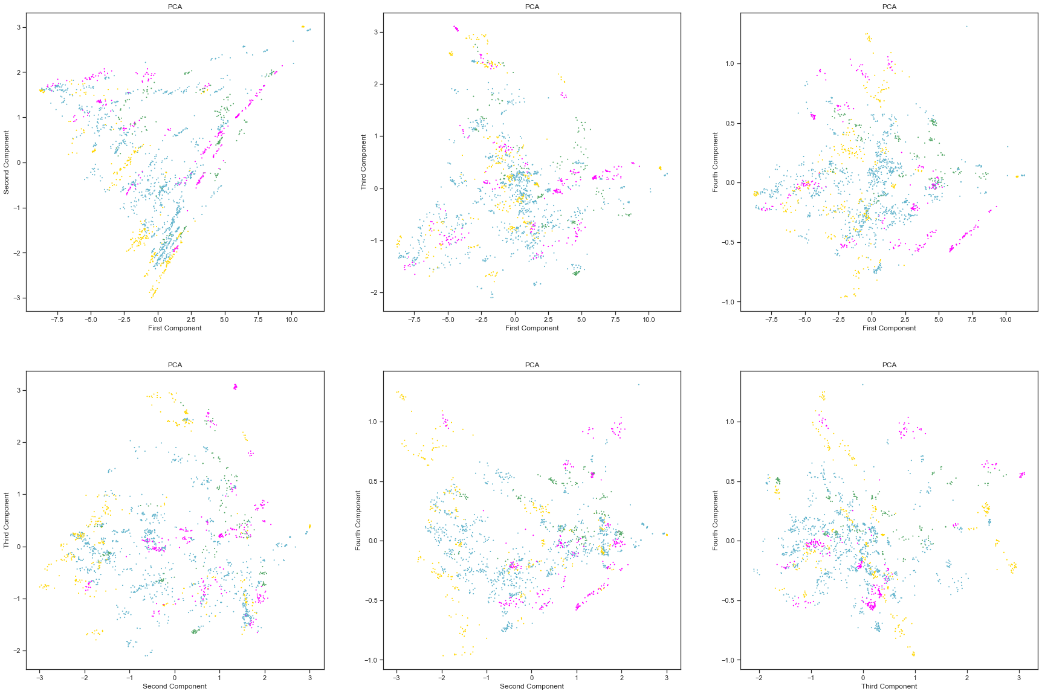

Slide 16
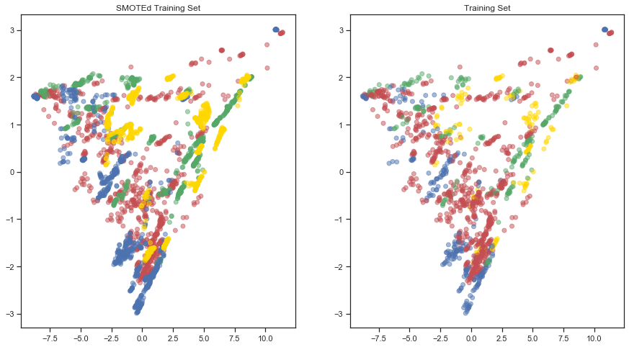
Synthetic Minority Oversampling Technique

Slide 17
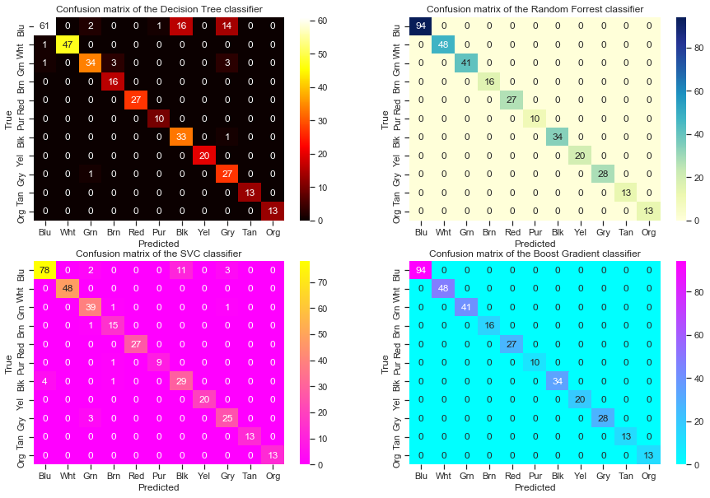
Machine learning for Color

Slide 18
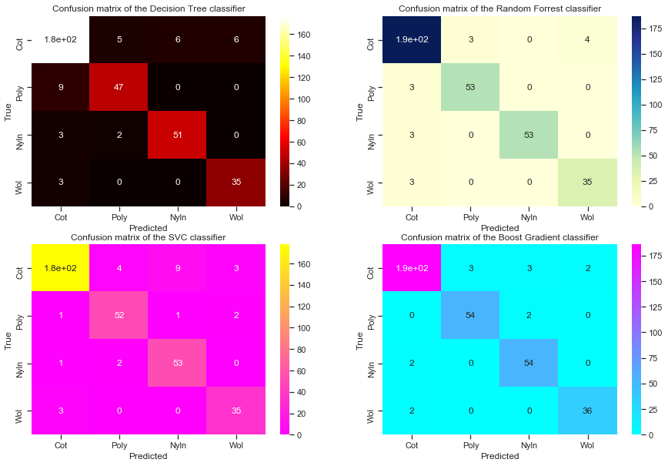
Machine learning for Material
When using the boost Gradient Classifier
for Cotton:
the sensitivity is 0.9690721649484536
the specificity is 0.9666666666666667
For Polyester:
the sensitivity is 0.9285714285714286
the specificity is 0.9826388888888888
For Nylon:
the sensitivity is 0.9285714285714286
the specificity is 0.9895833333333334
For Wool:
the sensitivity is 0.9473684210526315
the specificity is 0.9901960784313726

Slide 19
Conclusions
The current spectral data combined with 'random forrest and gradient boosting' classifier models show a high level of success for predicting color and material. The random Forrest model appears to have some difficulty with identifying and mis identifying cotton. In the Gradient Boosting Classifier Specificity for each of the catagories is in the high ninetieth percentile, and the the sensitivity is above 90% for each of the catagories. However, It is important to note that these models may be overfit specifically for material data due to the small sample size of the data. This can be corrected in the future with continued sampeling of textiles.

Slide 20
Further Experimentation
Collect more data more data needs to be collected to make truly understand the differences in materials
Construct a New spectrometer- create a spectrometer that can discern wavelengths deeper into the infrared or >940 nms and can take readings at a greater number of wavelengths. The ability to measure a larger number of wavelengths may prove useful in combination with a support vector classifier and/ or some sort of dimentionality reduction.
Sample blended fabric to create a regression model to predict percentages of fiber types
Try to Distinguish what dyes were used in each textile by either getting enhanced resolution on

